Slide 1

Final Project
Hangman
FriendlyAssembly
Hangman

Slide 2
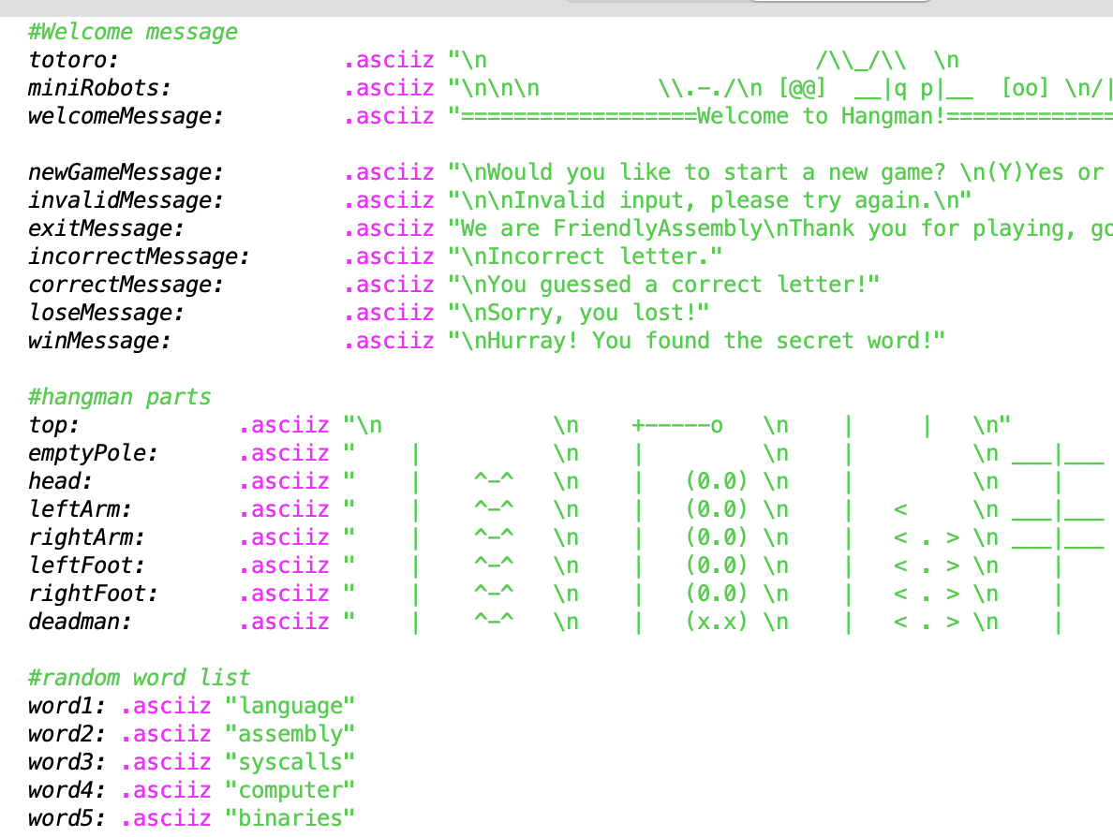
Part 1 : Setting up hangman drawing and word list

Slide 3
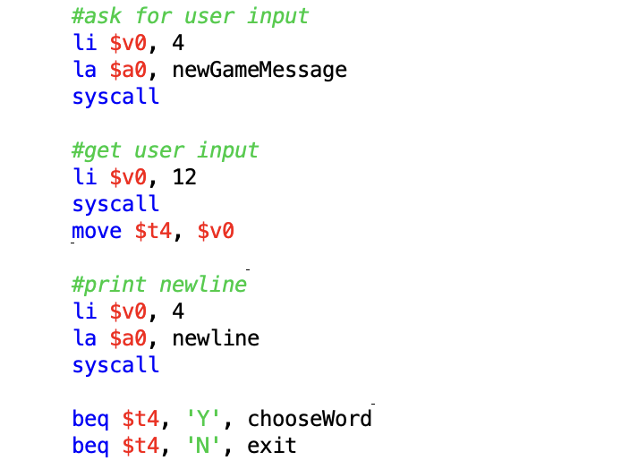
Part 2 : Asking user whether to proceed or not

Slide 4
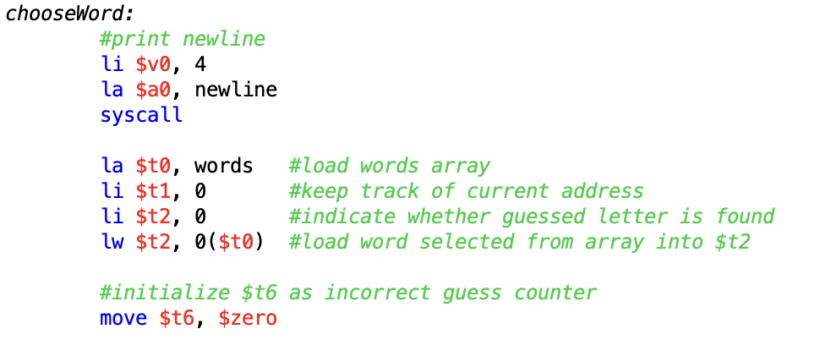
Part 3 : Setting up the word to be guessed

Slide 5
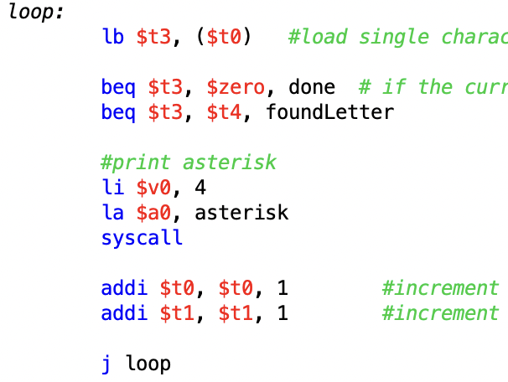
Part 4 : Checking each letter of the chosen word

Slide 6
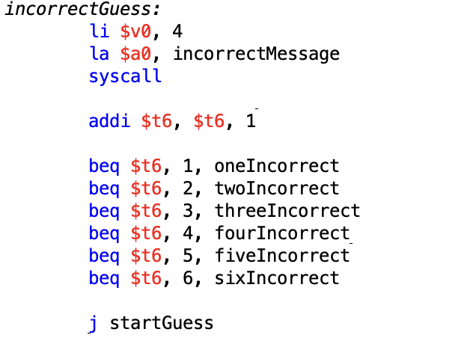
Part 5 : Increment of a counter for incorrect guesses

Slide 7
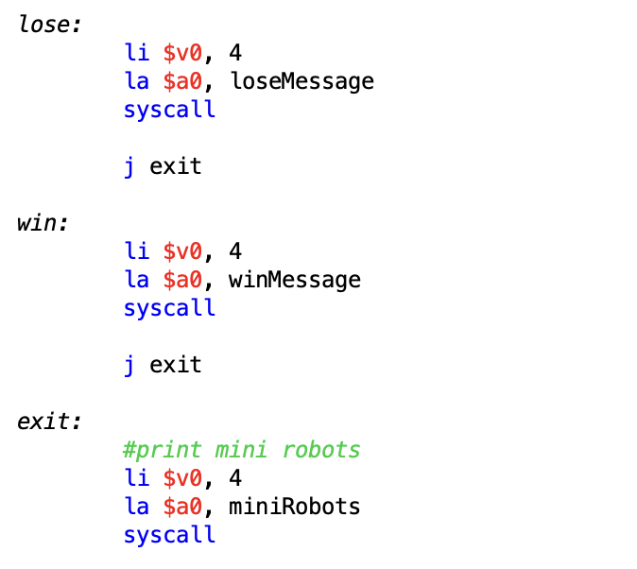
Part 6 : End of the game

Slide 8
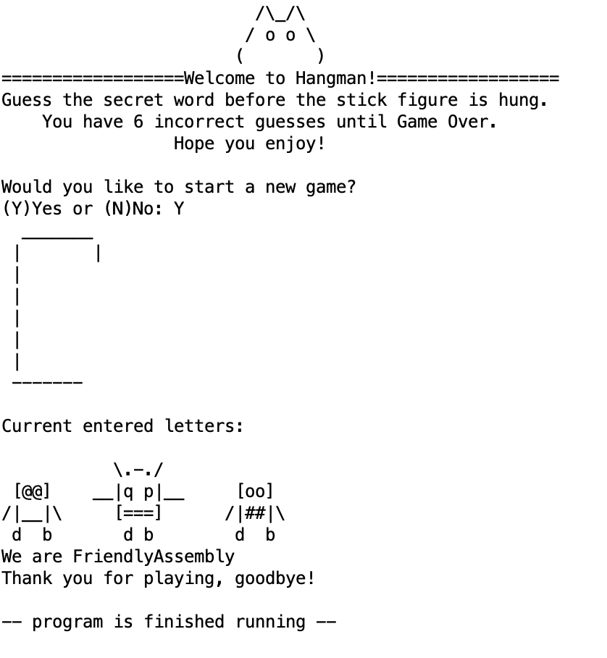
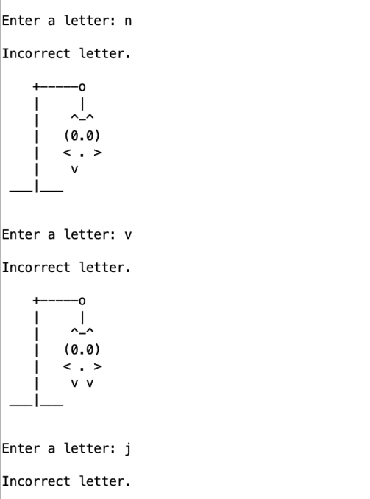
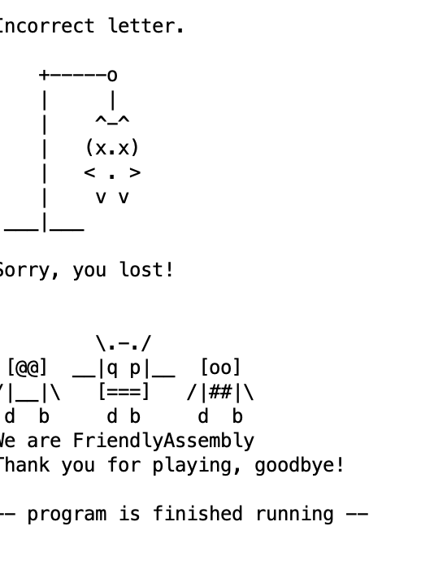
Output result

Slide 9
Thank you
Dayoung | Jarisse | Moller | Vanisa
FriendlyAssembly

